Slide 1
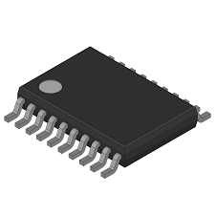
SPICE Simulation of Bootstrap Gate Driver with Half-Bridge Inverter Using LM5116
Sandesh Rajendra Narake

Slide 2
Introduction To Bootstrapping
In a half-bridge, the high-side MOSFET’s source is floating (moves with switching node).
To turn it on, the gate must be driven above the supply voltage.
Direct drive is not possible → special technique needed.
Bootstrap solution:
Uses a diode + capacitor.
When low-side is ON → capacitor charges.
When high-side is ON → capacitor provides floating supply to gate.
Simple, low-cost, non-isolated method to drive high-side.

Slide 3
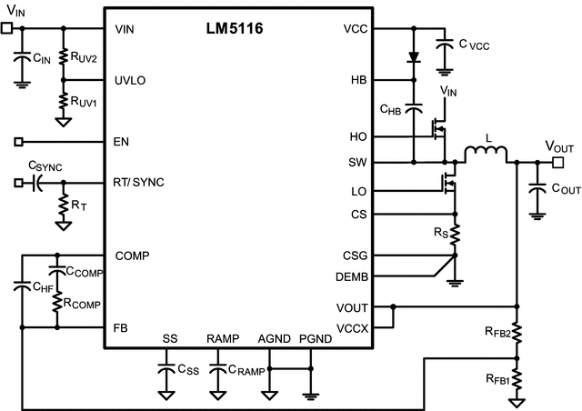
Circuit Diagram

Slide 4
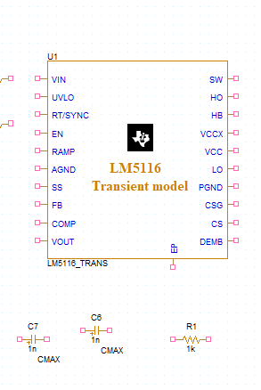
Simulation Setup
01
Software Selection
Use PSPICE for comprehensive circuit analysis and verification.
02
Circuit Analysis
PSPICE analyzes voltage, current, and component behavior before hardware implementation.
03
Simulation Types
Perform transient, AC, DC, and parametric analysis for complete circuit characterization.
04
Design Verification
Saves time and cost by validating designs through simulation before prototyping.

Slide 5
Montserrat Bold
Primary Documentation
LM5116 Datasheet and Product Information
LM5116 Failure/Application Issues, PCB Layout Guideline
LM5116 Evaluation Board / Application Notes
LM5116 — Wide Range Synchronous Buck Controller (TI Datasheet / Product Folder)
Application Guides
AN-1713: LM5116-12 Evaluation Board
LM5116 Datasheet (SNVS499, Rev H, etc.)
Technical Support
Texas Instruments (TI) E2E Support Forum

Slide 6
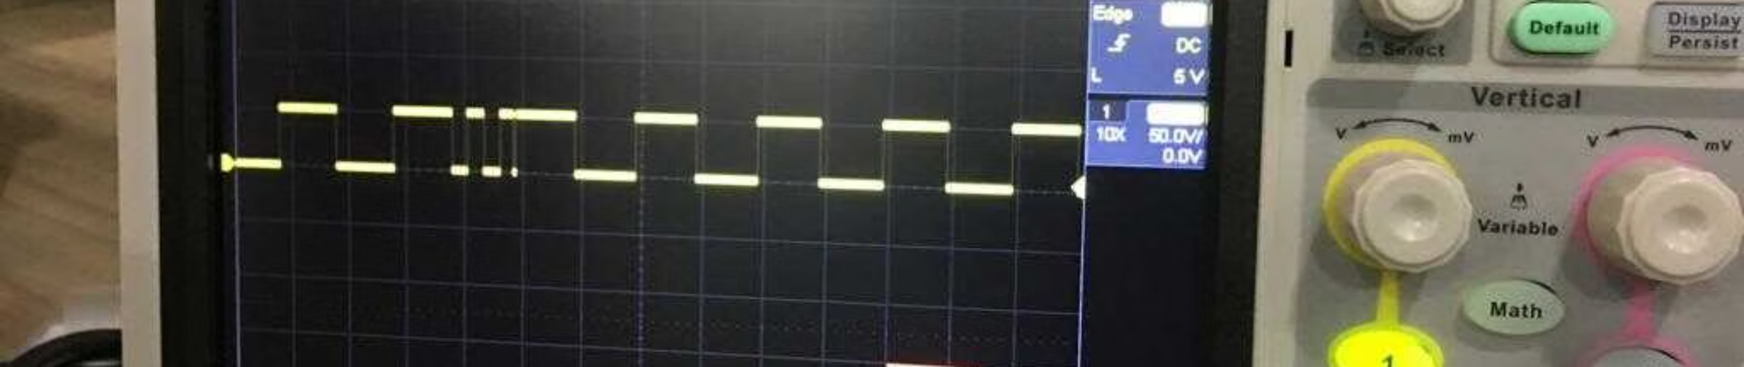
Conclusion
Effective Solution
Simulation Benefits
Design Advantages
The bootstrap gate driver provides a simple and effective method to drive high-side MOSFETs in half-bridge inverters.
SPICE/PSPICE simulation enables comprehensive analysis of gate voltages, capacitor behavior, and load response.
This approach saves time, cost, and prevents hardware errors through thorough pre-validation.

